Slide 1

Machine Learning
Lecture 3 – Ensemble Methods & Time Series

Slide 2
Overview
Ensemble Methods
Bagging
Voting
Boosting
Stacking
XG-Boost
Multi-Class Classification
Time Series
Time Series Forecasting Methods

Slide 3
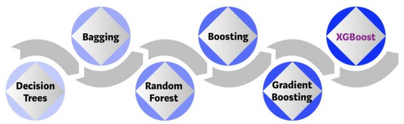
Ensemble Methods
Idea: The combination of multiple estimators (Classifier/Regressor) is better than a single estimator.
Estimators are typically decision trees, but any estimator can be used (e.g. Multiple Linear/Logistic Regressions).

Slide 4
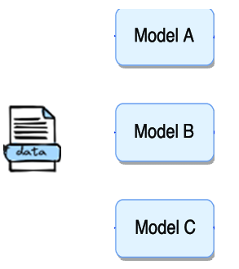
Voting
Train multiple estimators of different type (algorithm) in the same training set.
For each new instance:
Each estimator generates an output.
The final output is decided using hard or soft voting.
Hard Voting: The output becomes the majority vote (Classification).
Soft Voting:
Classification: Each estimator produces a probability of the instance belonging to a specific class. Then, we compute the average probability for each class. Finally, we select the class with the highest assigned probability.
Regression: The output is the average output of all estimators.
Hard/Soft Voting

Slide 5
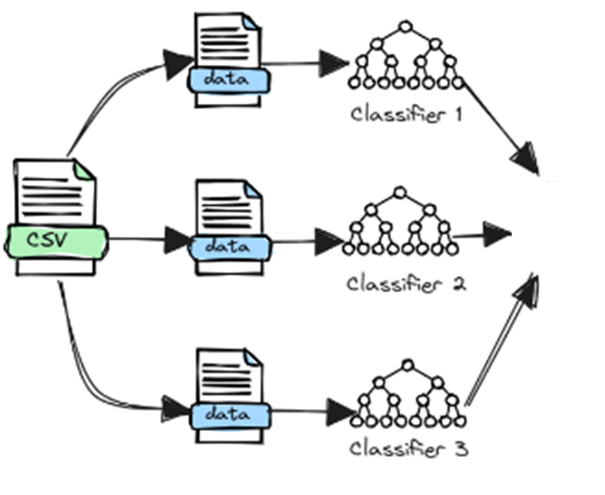



Bagging
Combines multiple estimators of the same type.
Each estimator is trained on a subset of the initial training set (different observations). The subsets are created using sampling with replacement.
For each new instance, each model produces an output. Then, we calculate the final output as below:
Averaging: The average value of all estimators (Regression).
Majority Vote: The class with most of the votes (Classification).
$$\hat{y_{1}}$$
$$\hat{y_{2}}$$
Hard ή Soft Voting
$$\hat{y_{3}}$$

Slide 6
Voting vs Bagging
Settings | Voting | Bagging
Estimator Types | Different | Same
Dataset | Same | Subsets (same features, different samples)
Goal | Combine strengths of diverse models | Reduce variance and prevent overfitting
Sampling | No sampling | Sampling with replacement
Output Combination | Hard/Soft voting | Averaging/Majority vote
Example | Voting: (Logistic + Decision Tree) | Random Forest (N Decision Trees)

Slide 7
Random Forest
Uses bagging to train multiple decision trees.
Differs from bagging by also utilizing random features for each decision tree.
Idea: Multiple trees will examine how multiple combinations of the features affect the final decision.
Benefits:
Improves generalization.
Becomes robust to outliers (extremely uncommon inputs) & noisy observations.
Usually works well for classification tasks with small amount of observations.

Slide 8
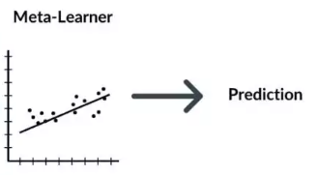
Stacking
Idea: Different model types extract different patterns from each dataset, which result in different predictions. A meta-learner can be trained to utilize these predictions and estimate the final output.
Meta-learners are typically simple models, such as Linear Regression or Logistic Regression that are trained using the outputs of each model.
Similar to voting, but utilize an ML method to combine the outputs, instead of hard/soft voting.
Meta-Learner (Estimator)
Input: ModelA(x), ModelB(x), ModelC(x)
Output: Target y

Slide 9
Boosting

Slide 10
Gradient Boosting

Slide 11
Extreme Gradient Boosting (XG-Boost)

Slide 12
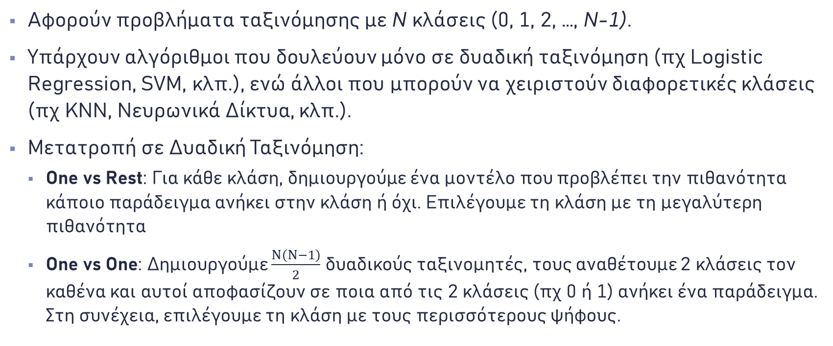
Multi-Class Classification
Αφορούν προβλήματα ταξινόμησης με N κλάσεις (0, 1, 2, …, N-1).
Υπάρχουν αλγόριθμοι που δουλεύουν μόνο σε δυαδική ταξινόμηση (πχ Logistic Regression, SVM, κλπ.), ενώ άλλοι που μπορούν να χειριστούν διαφορετικές κλάσεις (πχ KNN, Νευρωνικά Δίκτυα, κλπ.).
Μετατροπή σε Δυαδική Ταξινόμηση:
One vs Rest: Για κάθε κλάση, δημιουργούμε ένα μοντέλο που προβλέπει την πιθανότητα κάποιο παράδειγμα ανήκει στην κλάση ή όχι. Επιλέγουμε τη κλάση με τη μεγαλύτερη πιθανότητα
One vs One: Δημιουργούμε $\frac{Ν\left(Ν−1\right)}{2}$ δυαδικούς ταξινομητές, τους αναθέτουμε 2 κλάσεις τον καθένα και αυτοί αποφασίζουν σε ποια από τις 2 κλάσεις (πχ 0 ή 1) ανήκει ένα παράδειγμα. Στη συνέχεια, επιλέγουμε τη κλάση με τους περισσότερους ψήφους.

Slide 13
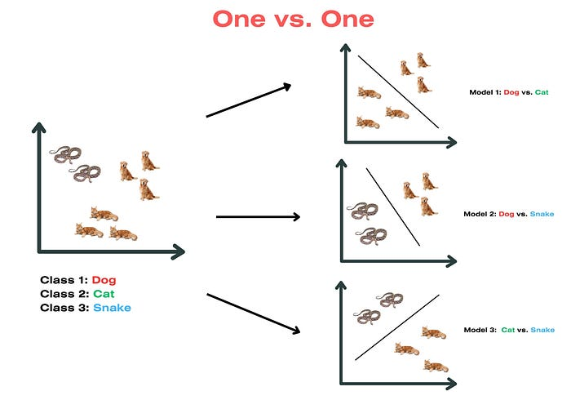
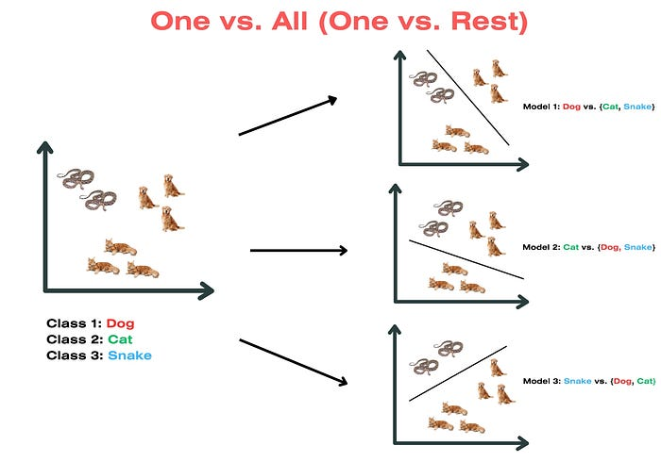
One-vs-One & One-vs-Rest

Slide 14
Time Series (1)
Sequential Data (Time-dependent variables).
Time series analysis:
Trend: Whether the values increase or decrease (move away from the average) or remain around the average over a specified period.
Seasonality: Typical shifts in the trend (e.g., the temperature increases every summer, while it decreases during winter).
Cyclicality: Unusual shifts in the trend, without obvious patterns (e.g., Cryptocurrency trend shifts).
Irregularity: Small increases or decreases of the variable that cannot easily be explained (e.g., noise).

Slide 15
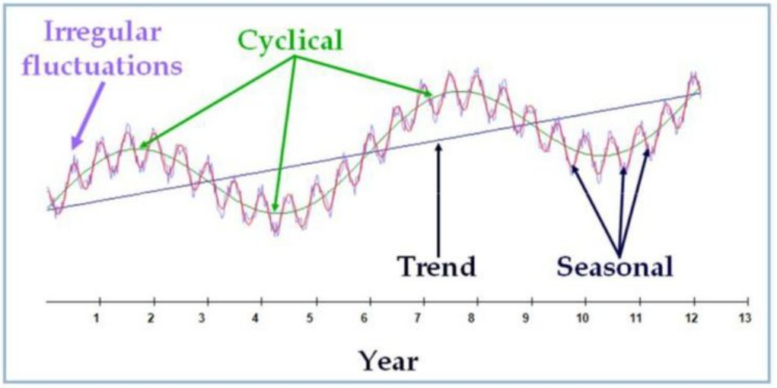

Time Series (2)
$$X(t)=T\left(t\right)+S\left(t\right)+R(t)$$

Slide 16
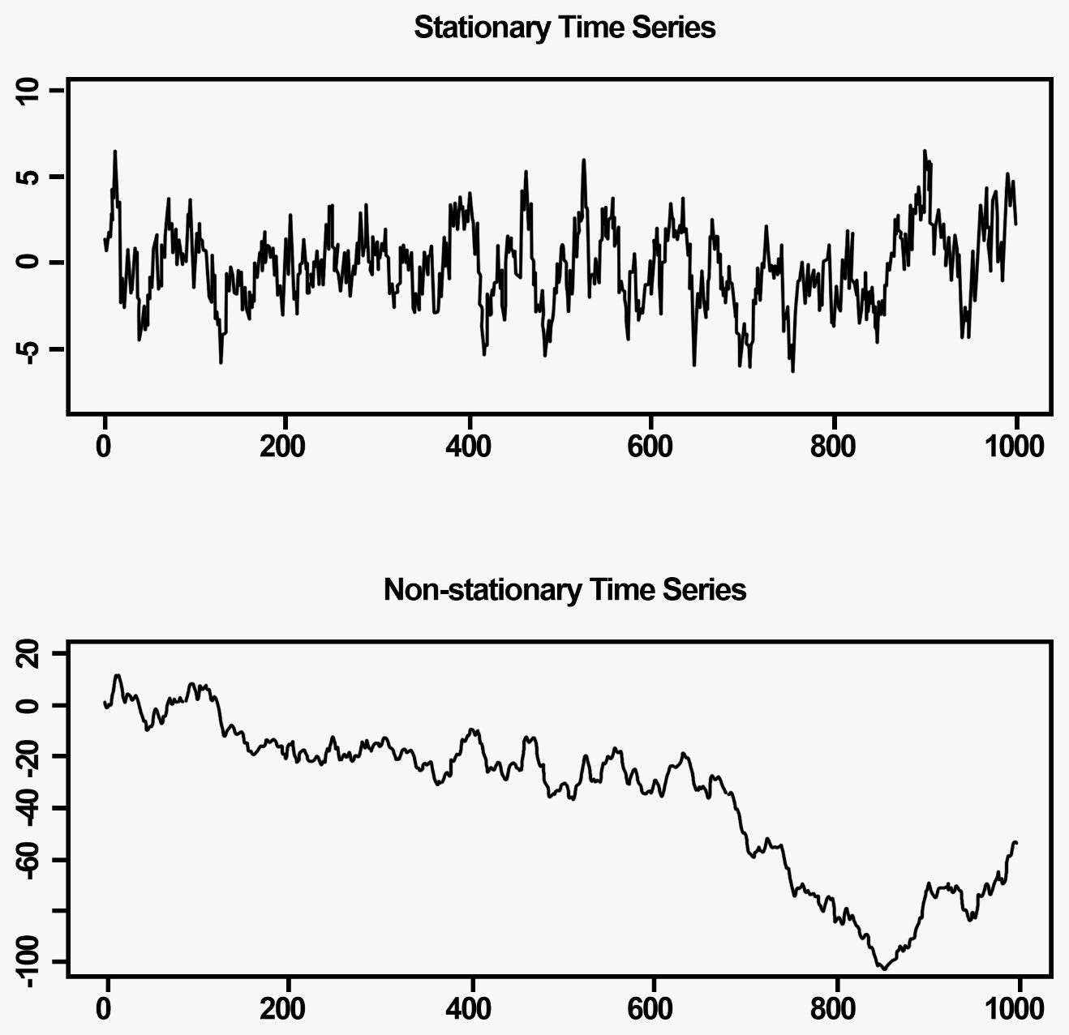
Stationarity
Non-stationary: A time series which constantly shifts its value away from the average.
Stationary: A time series whose value stays around the average.
It’s always easier to estimate stationary values.

Slide 17
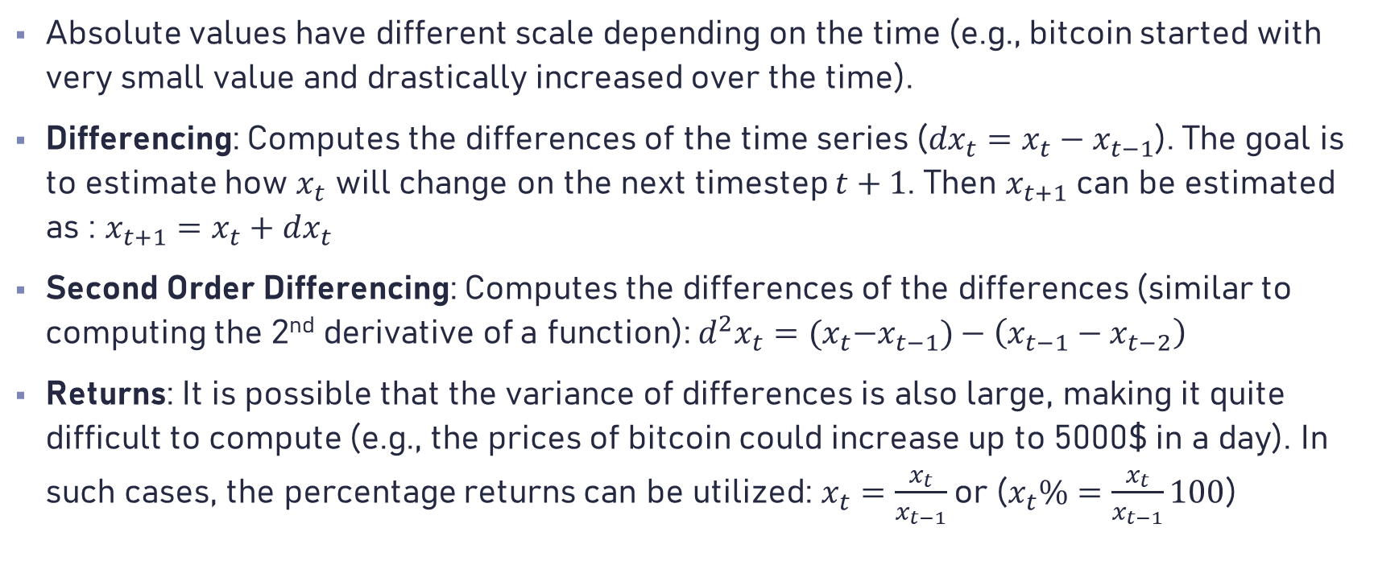
Non-Stationary to Stationary
Absolute values have different scale depending on the time (e.g., bitcoin started with very small value and drastically increased over the time).
Differencing: Computes the differences of the time series (${dx}_{t}=x_{t}−x_{t−1}$). The goal is to estimate how $x_{t}$ will change on the next timestep $t+1$. Then $x_{t+1}$ can be estimated as : $x_{t+1}=x_{t}+dx_{t}$
Second Order Differencing: Computes the differences of the differences (similar to computing the 2nd derivative of a function): ${d^{2}x}_{t}={(x}_{t}−x_{t−1})−\left(x_{t−1}−x_{t−2}\right)$
Returns: It is possible that the variance of differences is also large, making it quite difficult to compute (e.g., the prices of bitcoin could increase up to 5000$ in a day). In such cases, the percentage returns can be utilized: $x_{t}=\frac{x_{t}}{x_{t−1}}$ or ($x_{t}\%=\frac{x_{t}}{x_{t−1}}100$)

Slide 18
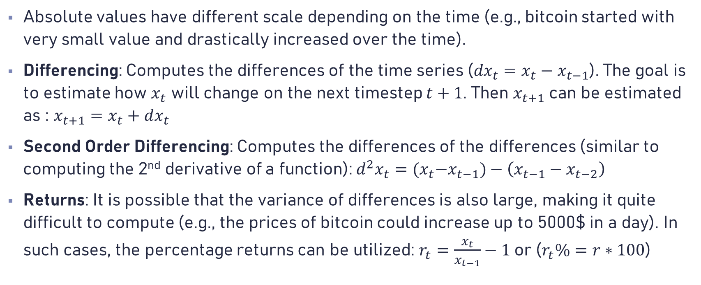
Non-Stationary to Stationary
Absolute values have different scale depending on the time (e.g., bitcoin started with very small value and drastically increased over the time).
Differencing: Computes the differences of the time series (${dx}_{t}=x_{t}−x_{t−1}$). The goal is to estimate how $x_{t}$ will change on the next timestep $t+1$. Then $x_{t+1}$ can be estimated as : $x_{t+1}=x_{t}+dx_{t}$
Second Order Differencing: Computes the differences of the differences (similar to computing the 2nd derivative of a function): ${d^{2}x}_{t}={(x}_{t}−x_{t−1})−\left(x_{t−1}−x_{t−2}\right)$
Returns: It is possible that the variance of differences is also large, making it quite difficult to compute (e.g., the prices of bitcoin could increase up to 5000$ in a day). In such cases, the percentage returns can be utilized: $r_{t}=\frac{x_{t}}{x_{t−1}}−1$ or ($r_{t}\%=r∗100$)

Slide 19
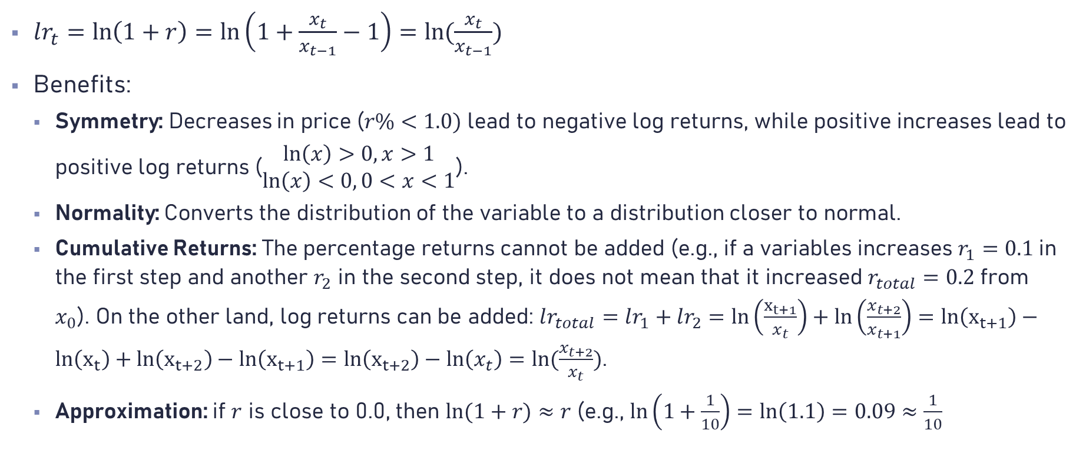
Log Returns
$lr_{t}=\ln\left(1+r\right)=\ln\left(1+\frac{x_{t}}{x_{t−1}}−1\right)=ln⁡(\frac{x_{t}}{x_{t−1}})$
Benefits:
Symmetry: Decreases in price ($r\%<1.0)$ lead to negative log returns, while positive increases lead to positive log returns ($\begin{matrix}\ln\left(x\right)>0, x>1 \\ \ln\left(x\right)<0, 0<x<1\end{matrix}$).
Normality: Converts the distribution of the variable to a distribution closer to normal.
Cumulative Returns: The percentage returns cannot be added (e.g., if a variables increases $r_{1}=0.1$in the first step and another $r_{2}$ in the second step, it does not mean that it increased $r_{total}=0.2$ from $x_{0}$). On the other land, log returns can be added: $lr_{total}=lr_{1}+lr_{2}=ln\left(\frac{x_{t+1}}{x_{t}}\right)+\ln\left(\frac{x_{t+2}}{x_{t+1}}\right)=ln\left(x_{t+1}\right)−ln\left(x_{t}\right)+ln\left(x_{t+2}\right)−ln\left(x_{t+1}\right)=ln\left(x_{t+2}\right)−ln\left(x_{t}\right)=ln⁡(\frac{x_{t+2}}{x_{t}})$.
Approximation: if $r$ is close to 0.0, then $ln⁡(1+r)≈r$ (e.g., $\ln\left(1+\frac{1}{10}\right)=\ln\left(1.1\right)=0.09≈\frac{1}{10}$

Slide 20
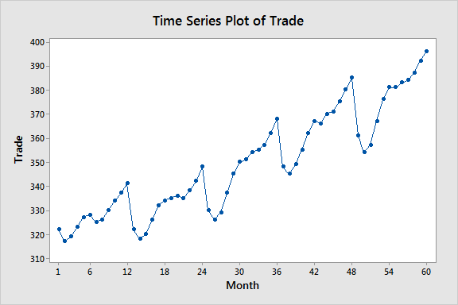
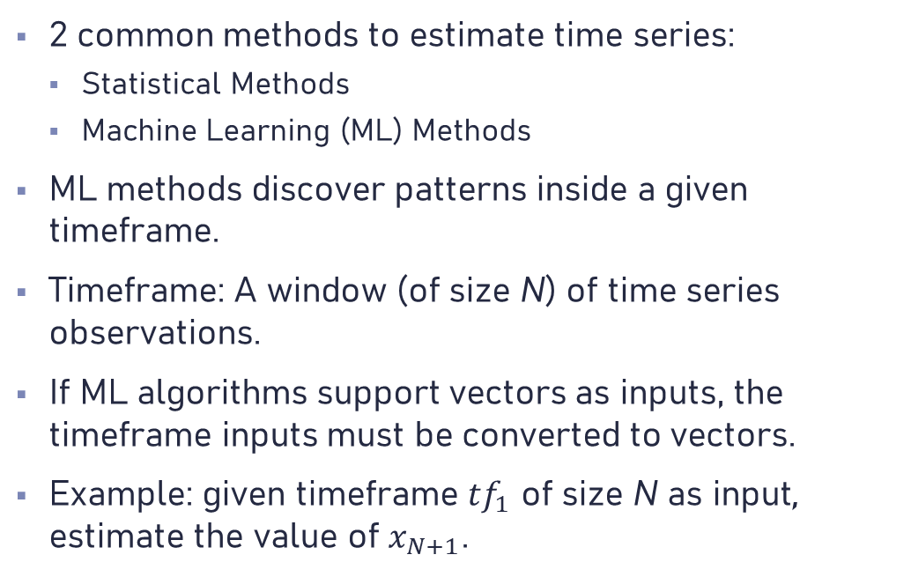

Time Series Forecasting Methods (1)
2 common methods to estimate time series:
Statistical Methods
Machine Learning (ML) Methods
ML methods discover patterns inside a given timeframe.
Timeframe: A window (of size N) of time series observations.
If ML algorithms support vectors as inputs, the timeframe inputs must be converted to vectors.
Example: given timeframe $tf_{1}$ of size N as input, estimate the value of $x_{N+1}$.
$$tf_{1}$$

Slide 21
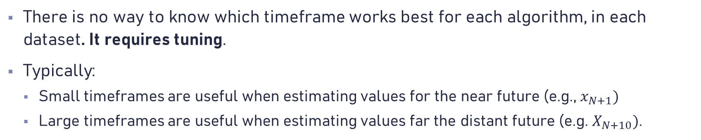
Time Series Forecasting Methods (2)
There is no way to know which timeframe works best for each algorithm, in each dataset. It requires tuning.
Typically:
Small timeframes are useful when estimating values for the near future (e.g., $x_{N+1})$
Large timeframes are useful when estimating values far the distant future (e.g. $X_{N+10})$.
Discovers patterns for the near future
Discovers patterns for the distant future

Slide 22
Machine Learning
Lecture 3 – Ensemble Methods & Time Series

